Slide 1

GLA University
Presentation on
Resume Analyzer
By G50
Kaustubh Dubey(201500332)
Shreyash Varshney (201500675)
Under the Guidance of
Dr. Mayank Srivastava
Resume Analyzer
Page - 1

Slide 2
Outlines
Introduction
Literature Review
Abstract
Project Overview
Features/Modules
Benefits and Impacts
Tools & Technologies
Implementation
Conclusion
References
Resume Analyzer
Page - 2

Slide 3
Introduction
In the world of recruitment and hiring - our Resume Analyzer. In an era where talent acquisition is more critical than ever, this tool is designed to empower both employers and job seekers by streamlining the resume evaluation process.
As we all know, the traditional method of manually reviewing hundreds or even thousands of resumes can be a time-consuming and often daunting task for HR professionals. Job applicants, on the other hand, face the challenge of ensuring their resumes stand out in a highly competitive job market.
Our Resume Analyzer addresses these challenges head-on by leveraging cutting-edge technology, including Natural Language Processing and Machine Learning, to transform the way resumes are assessed and matched to job openings.
Resume Analyzer
Page - 3
Notes:
Flutter is an open source framework by Google for building beautiful, natively compiled, multi-platform applications from a single codebase.

Slide 4
Literature Review
Identifying Key Research: We will aim to gather and analyze relevant studies, articles, and academic papers on resume analyzers to gain a comprehensive understanding of the current state of research in this field.
Assessing Effectiveness: We will evaluate the effectiveness and accuracy of existing resume analyzer tools by examining empirical studies and user feedback to understand their strengths and limitations.
Exploring Technical Aspects: We will delve into the technical aspects of resume analyzers, such as the algorithms, natural language processing techniques, and machine learning models employed, to understand how these tools function.
Examining User Experience: We will investigate the user experience of resume analyzers, exploring factors such as usability, interface design, and the impact on user satisfaction and engagement.
Addressing Bias and Fairness: We will explore issues related to algorithmic bias, fairness, and potential discrimination in resume analyzer tools to understand their implications for job seekers and recruiters.
Resume Analyzer
Page - 4
Notes:
Flutter is an open source framework by Google for building beautiful, natively compiled, multi-platform applications from a single codebase.

Slide 5
Research Paper Conclusion - 1
NLP based Extraction of Relevant Resume using Machine Learning
Approach –
Try to analyse resume using like out human brain does using Artificial neural network ANN, Using NLP
Tools used – Python, Jupiter notebook for model training.
Advantages – NLP enables the automatic extraction of relevant information from resumes, such as skills, work experience, education, and contact details.
Disadvantages – NLP may struggle with understanding ambiguous language or context-specific terminology. Resumes often contain industry-specific jargon or acronyms that can be misinterpreted, leading to inaccurate analyses.
Resume Analyzer
Page - 5
Notes:
Flutter is an open source framework by Google for building beautiful, natively compiled, multi-platform applications from a single codebase.

Slide 6
Research Paper Conclusion - 2
Resume Ranking using NLP and Machine Learning
Approach –
Using NLP(Natural Language Processing) and ML(Machine Learning) to rank the resumes according to the given constraint.
1. Parser System.
2. Candidate Skillset Database.
3. Resume Ranking algorithm.
Tools used – Python, Natural Language Toolkit (NLTK), PyCharm, Scrapy
Scrapy is a free, open-source web crawling framework written in Python. Use for extracting useful data from resume.
Advantages – Shows your rank for any job description and helpful for people targeting specific job.
Disadvantages – It only ranks resume according for specified job description.
Resume Analyzer
Page - 6
Notes:
Flutter is an open source framework by Google for building beautiful, natively compiled, multi-platform applications from a single codebase.

Slide 7
Research Paper Conclusion - 3
Smart Resume Analyser
Approach –
Use NLP to find potential resume.
The KNN Algorithm is used to categories the resumes into the appropriate categories.
Cosine Similarity is used to determine how well the candidate's resume matches the job description.
Tools used – Python, SpaCy
SpaCy is a free, open-source library for Natural Language Processing (NLP) in Python.
Advantages – Highly comprehensive system which not only finds best match for designation but also determine how well a resume match with job description which is good for candidate.
Disadvantages – It's not too good for recruiters because they just want best-fit resumes.
Resume Analyzer
Page – 7
Notes:
Flutter is an open source framework by Google for building beautiful, natively compiled, multi-platform applications from a single codebase.

Slide 8
Research Paper Conclusion - 4
Resume Screening Using Machine Learning and NLP
Approach –
This data is then used to rank the student’s resumes comparing their skills required in the job, this is done using the Named Entity Recognition(NER) like Apache OpenNLP .
Tools used – Random Forest, Multinomial Naïve Bayes, Logistic Regression, Linear Support Vector Machine Classifier, NLP.
Advantages – The Skill finder efficiently matches the Resumes according to the job role posted and successfully sends emails to the desired candidates.
Disadvantages – The Above systems has models that don’t have any way to improve themselves over the time, the models will be trained only once.
Resume Analyzer
Page - 8

Slide 9
Research Paper Conclusion - 5
Named Entity Recognition based Resume Parser and Summarizer
Approach –
Using spaCy, a powerful natural language processing (NLP) package, this study suggests a machine learning method to phrase matching in resumes, focused on the extraction of specific entities.
Tools used – spaCy, Tokenization(used for text categorization), Named Entity Recognition, NLP and other features of spaCy.
Advantages – While parsing, it maintains track of the terms in order to classify people. Specific Important entities are extracted from the resume document and then it is stored for later classification
Disadvantages – Consideration of different language is very hard.
Resume Analyzer
Page - 9
Notes:
Flutter is an open source framework by Google for building beautiful, natively compiled, multi-platform applications from a single codebase.

Slide 10
Research Paper Conclusion - 6
Resume Parser with Natural Language Processing
Approach –
This proposed system consists of three steps to parsing resume: 1) Receive resume files from candidate 2) Convert resume file to the text format 3) Extracting necessary information.
Tools used – Named Entity Recognition(part of NLP), Spacy, NER, PyMuPDF, PKL(Pickle format for the train dataset).
Advantages –
To help reduce human error and fatigue in screening resumes.
To parsing and matching the similarities between a candidate's resume and job description makes the hiring process easier and more efficient.
Disadvantages –
1. there is not enough dataset in this project, and the information extracted does not cover all the details of the resume, such as experience.
Resume Analyzer
Page - 10
Notes:
Flutter is an open source framework by Google for building beautiful, natively compiled, multi-platform applications from a single codebase.

Slide 11
Research Paper Conclusion - 7
An Automated Resume Screening System Using NLP and Machine Learning
Approach –
In this section, we describe the concepts that facilitate the construction of the proposed Automated Resume Screening System. The system works in two phases as described below
First Phase - First phase include total five steps. Information extraction – Tokenization, Stemming and lemmatization, Parts of speech tagging, Chunking
Second Phase - Content based candidate recommendation- Vectorization and cosine similarity, TF-IDF, Vector Space Model
Tools used – Python, Py-charm.
Advantages – Resume analyzers can quickly process and analyze a large number of resumes, saving time for recruiters and employers.
Disadvantages –Resume analyzers may struggle to understand the context of certain achievements or experiences, leading to potential misinterpretations.
Resume Analyzer
Page - 11
Notes:
Flutter is an open source framework by Google for building beautiful, natively compiled, multi-platform applications from a single codebase.

Slide 12
Research Paper Conclusion - 8
Smart Resume Analyser
Approach –
We have check candidate CV by evaluating graph using Machine Learning and In application we have three entities Admin Module, Candidate Module and CV analysis.
Tools used – Py-Charm
Advantages – Resume analyzers can provide an objective assessment of resumes based on predefined criteria.
Disadvantages –
A heavy reliance on keyword matching may lead to overlooking well-qualified candidates who use different terminology.
Resume Analyzer
Page - 12
Notes:
Flutter is an open source framework by Google for building beautiful, natively compiled, multi-platform applications from a single codebase.

Slide 13
Research Paper Conclusion - 9
Smart Resume Analyser
Approach –
Use NLP to find potential resume.
It converts the resume into HTML & JSON format using PDF Minor.
we are using multivariate logistic regression to calculate accuracy and rank according to that.
Tools used – Python, HTML, PDF Miner.
Advantages – It reprocess the whole thing and handles the errors side by side
Disadvantages – It is a time consuming process.
Resume Analyzer
Page - 13
Notes:
Flutter is an open source framework by Google for building beautiful, natively compiled, multi-platform applications from a single codebase.

Slide 14
Research Paper Conclusion - 10
A machine learning approach for a resume recommendation system(VIT,vellore)
Approach –
After the cleaning of the data two steps are needed to be taken: 1. Classification, 2. Recommendation.
Classification was done by using four models i.e. Random forest, multinomial naïve bytes, Logistic Regression, . Linear Support Vector Classifier
Recommendation was done using Content Based Recommendation using Cosine Similarity and k-Nearest Neighbor's.
Tools used – Python, SpaCy, pynum
SpaCy is a free, open-source library for Natural Language Processing (NLP) in Python.
Advantages – A planned system with different levels of control which makes the result more accurate.
Disadvantages – It’s a bit complex system as different levels has different models each.
Resume Analyzer
Page - 14
Notes:
Flutter is an open source framework by Google for building beautiful, natively compiled, multi-platform applications from a single codebase.

Slide 15
Research Paper Conclusion - 11
Information Extraction from Resume(Prasana Pokharel, University of Wolverhampton)
Approach –
Use NLP to find potential resume.
NLTK and Spacy which are used to execute NLP task like eliminating stop words, Lower casing, Tokenization, Lemmatization..
Different modules and libraries are used for the span of this research project.
Tools used – Python, SpaCy, NLTK.corus, pprint, OS
SpaCy is a free, open-source library for Natural Language Processing (NLP) in Python.
Advantages – The whole system is a simple but the result and word processing is comprehensive which helps in accurate result.
Disadvantages –
The process of the use of NLTK in the paper is not properly specified.
Resume Analyzer
Page - 15
Notes:
Flutter is an open source framework by Google for building beautiful, natively compiled, multi-platform applications from a single codebase.

Slide 16
Research Paper Conclusion - 12
Information NLP-Based Resume Screening and Job Recruitment Portal (Springer)
Approach –
Using the NLP to automate the whole process of hiring.
The KNN Algorithm is used to categories the resumes into the appropriate categories.
NLTK and Spacy which are used to execute NLP task like eliminating stop words, Lower casing, Tokenization, Lemmatization.
Tools used – Python, SpaCy, NLTK, Re, UTILS
SpaCy is a free, open-source library for Natural Language Processing (NLP) in Python.
NLTK is the NLP toolkit library.
Advantages – The whole system takes input of the resume and role provided, to give a score on the user’s resume.
Disadvantages – The scoring system in itself is not a very accurate way for recommendation on the improvement in the resume.
Resume Analyzer
Page - 16
Notes:
Flutter is an open source framework by Google for building beautiful, natively compiled, multi-platform applications from a single codebase.

Slide 17
Research Paper Conclusion - 13
CV analysis using Machine Learning (Doc Link)
Approach –
Use NLP to find potential resume.
The KNN Algorithm is used to categories the resumes into the appropriate categories.
Cosine Similarity is used to determine how well the candidate's resume matches the job description.
Tools used – Pandas, OS, IO, Utils, Spacy, print, Matcher, Multiprocessing, warnings, NLTK.corus and Re.
SpaCy is a free, open-source library for Natural Language Processing (NLP) in Python.
Advantages – The same scoring system is used in this process as well which can be easy to understand by the user.
Disadvantages – The scoring system in itself is not a very accurate way for recommendation on the improvement in the resume.
Resume Analyzer
Page - 17
Notes:
Flutter is an open source framework by Google for building beautiful, natively compiled, multi-platform applications from a single codebase.

Slide 18
Abstract
The Resume Analyzer is an automated solution to the recruitment process. It analyzes resumes and extracts required details such as name, contact details, experience, and qualifications from the resume. The system uses text mining technology to extract text from unstructured documents and convert it into data for further analysis. The extracted data is then stored in a database and sorted based on various parameters such as experience, qualification, age, etc. The system also schedules interviews based on the generated sorted list and sends automated emails to applicants.
The Resume Analyzer system aims to reduce efforts on both the candidate’s and company’s side1. Candidates can upload their resumes instead of filling lengthy application forms. The system can be adopted by companies as part of their recruitment process.
Resume Analyzer
Page - 18
Notes:
Flutter is an open source framework by Google for building beautiful, natively compiled, multi-platform applications from a single codebase.

Slide 19
Project Overview
The primary goal of our project is to modernize and streamline the recruitment process by providing a comprehensive tool that effectively analyzes, matches, and manages resumes. We aim to bridge the gap between employers seeking the perfect candidate and job seekers looking for their ideal career opportunity.
Resume Analyzer
Page - 19
Notes:
Flutter is an open source framework by Google for building beautiful, natively compiled, multi-platform applications from a single codebase.

Slide 20
Features/Modules
Resume Parsing: Automatically extracts structured information from resumes, including contact details, work experience, education, and skills.
Keyword Analysis: Identifies and categorizes relevant keywords and phrases, tailored to specific industries or job roles.
Skills Matching: Compares resume skills with job requirements to determine candidate suitability.
Quality Assessment: Evaluates resumes for errors, consistency, and readability, providing feedback for improvement.
Recommendations: Generates personalized suggestions to enhance resumes, increasing the chances of attracting employers.
Resume Comparison: Ranks candidates based on qualifications and compatibility with job descriptions.
Resume Analyzer
Page - 20
Notes:
Flutter is an open source framework by Google for building beautiful, natively compiled, multi-platform applications from a single codebase.

Slide 21
Features/Modules
User-Friendly Interface: Offers an intuitive interface for users to submit, edit, and view analysis results.
Security and Privacy: Ensures the confidentiality and safety of sensitive resume data, complying with data protection regulations.
Integration: Seamlessly integrates with job portals and applicant tracking systems (ATS) for streamlined recruitment.
Machine Learning : Utilizes machine learning to improve analysis accuracy and provide dynamic recommendations.
Resume Analyzer
Page - 21
Notes:
Flutter is an open source framework by Google for building beautiful, natively compiled, multi-platform applications from a single codebase.

Slide 22
Benefits & Impacts
Benefits for Employers:
Time Savings: The Resume Analyzer significantly reduces the time spent on initial resume screening. HR professionals can focus on more strategic aspects of recruitment.
Enhanced Efficiency: Employers can identify the best-fit candidates more efficiently, leading to faster hiring cycles and reduced time-to-fill vacancies.
Reduced Bias: By relying on objective data and algorithms, the Resume Analyzer helps minimize unconscious bias in the screening process, leading to fairer evaluations.
Resume Analyzer
Page - 22
Notes:
Flutter is an open source framework by Google for building beautiful, natively compiled, multi-platform applications from a single codebase.

Slide 23
Benefits & Impacts
Benefits for Job Seekers:
Improved Matches: Job seekers receive personalized job recommendations based on their skills and experience, increasing their chances of finding the right fit.
Time Savings: Applicants no longer need to spend excessive time customizing their resumes for each job application. The Resume Analyzer helps them present their qualifications effectively.
Confidence Building: Job seekers gain confidence in their job applications, knowing that their resumes are being objectively evaluated.
Resume Analyzer
Page - 23
Notes:
Flutter is an open source framework by Google for building beautiful, natively compiled, multi-platform applications from a single codebase.

Slide 24
Tools & Technologies
Python is a versatile programming language, and PySALARI is a Python library specifically designed for parsing and analyzing resumes. This combination allows you to leverage Python's extensive ecosystem and PySALARI's resume-specific capabilities to build a powerful and efficient Resume Analyzer.
Here are some benefits of using Python and PySALARI for your Resume Analyzer:
Ease of Use: Python is known for its readability and ease of use, making it an excellent choice for both rapid development and maintenance of your Resume Analyzer.
Rich Ecosystem: Python offers a vast ecosystem of libraries and tools for natural language processing (NLP), machine learning, and data analysis. You can easily integrate these libraries into your Resume Analyzer to enhance its capabilities.
Resume Analyzer
Page - 24
Notes:
Flutter is an open source framework by Google for building beautiful, natively compiled, multi-platform applications from a single codebase.

Slide 25
Tools & Technologies
PySALARI Features: PySALARI is tailored for resume parsing and analysis, making it well-suited for your project. It can extract essential information from resumes, such as contact details, work experience, skills, and education.
Community Support: Both Python and PySALARI have active communities, which means you can find ample resources, documentation, and support when developing and maintaining your Resume Analyzer.
Resume Analyzer
Page - 25
Notes:
Flutter is an open source framework by Google for building beautiful, natively compiled, multi-platform applications from a single codebase.

Slide 26
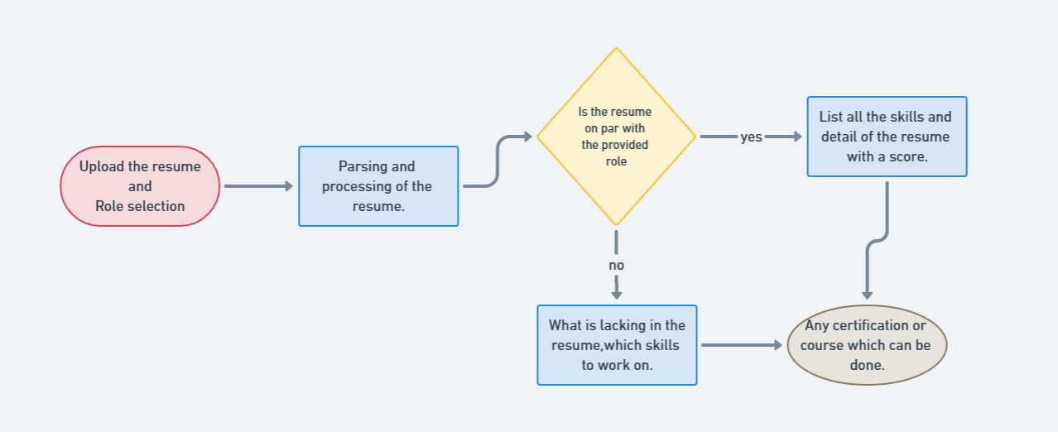
Flowchart
Resume Analyzer
Page - 26
Notes:
Flutter is an open source framework by Google for building beautiful, natively compiled, multi-platform applications from a single codebase.

Slide 27
Upload Resume and Role Selection
Design the system to support various file formats commonly used for resumes, such as PDF, DOC, DOCX, or TXT.
Implement validation checks to ensure that users only upload files in supported formats.
Include a progress indicator to show users the status of their upload. This is especially important for larger files that may take some time to process.
Display clear error messages to guide users on how to address any issues with their uploaded resumes.
Offer a list of predefined job roles or industries that users can choose from. This list should cover a wide range of professions and industries.
Implement a search functionality to allow users to quickly find specific roles of interest.
Include filters or categories to help users narrow down their choices based on industry, experience level, or other relevant criteria.
Resume Analyzer
Page - 27
Notes:
Flutter is an open source framework by Google for building beautiful, natively compiled, multi-platform applications from a single codebase.

Slide 28
Parsing and Processing of the Resume.
Extract the text content from the uploaded resume file. This is a crucial step as it provides the raw data for further processing.
Identify and understand the structure of the resume document, including sections like personal information, education
Implement algorithms for recognizing entities such as names, addresses, phone numbers, email addresses, educational institutions, job titles, and dates. This helps in categorizing and structuring the information., work experience, skills, and additional details.
Analyze the entire resume for keywords relevant to specific industries or job roles. This helps in assessing the overall suitability of the candidate for particular positions.
Resume Analyzer
Page - 28
Notes:
Flutter is an open source framework by Google for building beautiful, natively compiled, multi-platform applications from a single codebase.

Slide 29
List all the Skill and Details of the resume with a score.
Identify and extract skills mentioned in the resume using natural language processing (NLP) techniques.
Utilize a predefined list of skills or dynamically generate a list based on common industry keywords.
Assign a relevance score to each extracted skill. This score can be based on factors such as the frequency of the skill in the resume, the context in which it appears, or its importance for the selected job roles.
Calculate an overall score for the resume by aggregating the relevance scores of skills and details. This can be a weighted sum, where certain elements (e.g., work experience) contribute more to the overall score.
Display the list of skills and details along with their corresponding relevance scores in a clear and user-friendly format. This can be in the form of a table, chart, or summary report.
Resume Analyzer
Page - 29
Notes:
Flutter is an open source framework by Google for building beautiful, natively compiled, multi-platform applications from a single codebase.

Slide 30
What is lacking in the resume, Which Skill to work on.
Compare the skills mentioned in the resume with the desired skills for the selected job roles.
Identify skills that are commonly required for the chosen roles but are not present or are underrepresented in the resume.
Offer suggestions on how the user can acquire or enhance the identified missing skills.
Provide links to relevant online courses, certifications, workshops, or other learning resources that can help bridge the skill gaps.
Offer context for each suggested skill by explaining why it is essential for the selected roles. This helps users understand the relevance and importance of the recommended skills.
Break down skill development into achievable goals and milestones. This helps users create a realistic plan for improving their resume over time.
Resume Analyzer
Page - 30
Notes:
Flutter is an open source framework by Google for building beautiful, natively compiled, multi-platform applications from a single codebase.

Slide 31
Any Certification or course which can be done.
Based on the identified skill gaps, suggest specific certifications or courses that can help the user acquire those skills.
Offer details about the suggested certifications, including the learning platform, duration, and any prerequisites.
Include information about the industry recognition and value of each certification.
Integrate with online learning platforms to provide direct links to the recommended certifications or courses.
Streamline the process for users to enroll in the suggested programs.
Prioritize certifications that are widely recognized in the industry or relevant to the selected job roles.
Provide context on why each certification is beneficial for the user's career goals.
Resume Analyzer
Page - 31
Notes:
Flutter is an open source framework by Google for building beautiful, natively compiled, multi-platform applications from a single codebase.

Slide 32
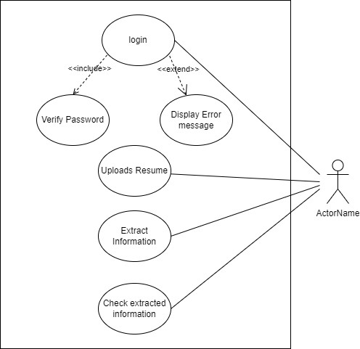
Use case Diagram
Resume Analyzer
Page - 32
Notes:
Flutter is an open source framework by Google for building beautiful, natively compiled, multi-platform applications from a single codebase.

Slide 33
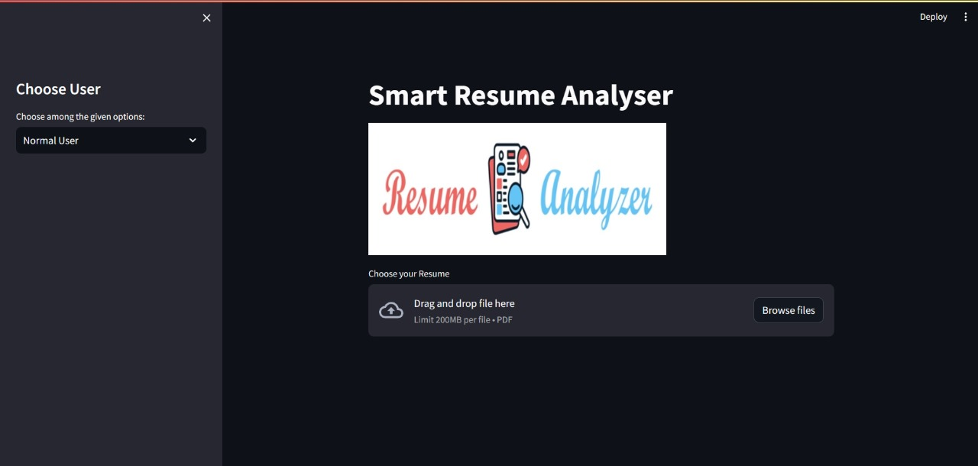
Implementation
1. Starting Window of Resume Analyzer
When a user visits the smart resume analyzer, it can provide guidance on the correct format for uploading the resume. This guidance might include suggestions for file types (e.g., PDF, DOCX), file naming conventions, and any specific sections or formatting requirements needed for accurate analysis.
Resume Analyzer
Page – 33
Notes:
Flutter is an open source framework by Google for building beautiful, natively compiled, multi-platform applications from a single codebase.

Slide 34
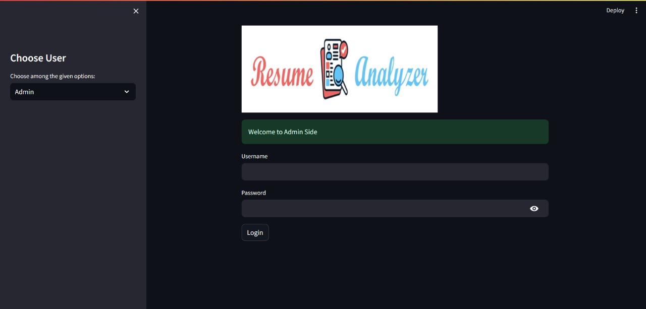
2. Admin Side Starting Window
In the Admin panel, after entering the username and password, additional security measures can be implemented, such as multi-factor authentication or role-based access control, to ensure only authorized personnel can access sensitive candidate data.
Resume Analyzer
Page - 34
Notes:
Flutter is an open source framework by Google for building beautiful, natively compiled, multi-platform applications from a single codebase.

Slide 35
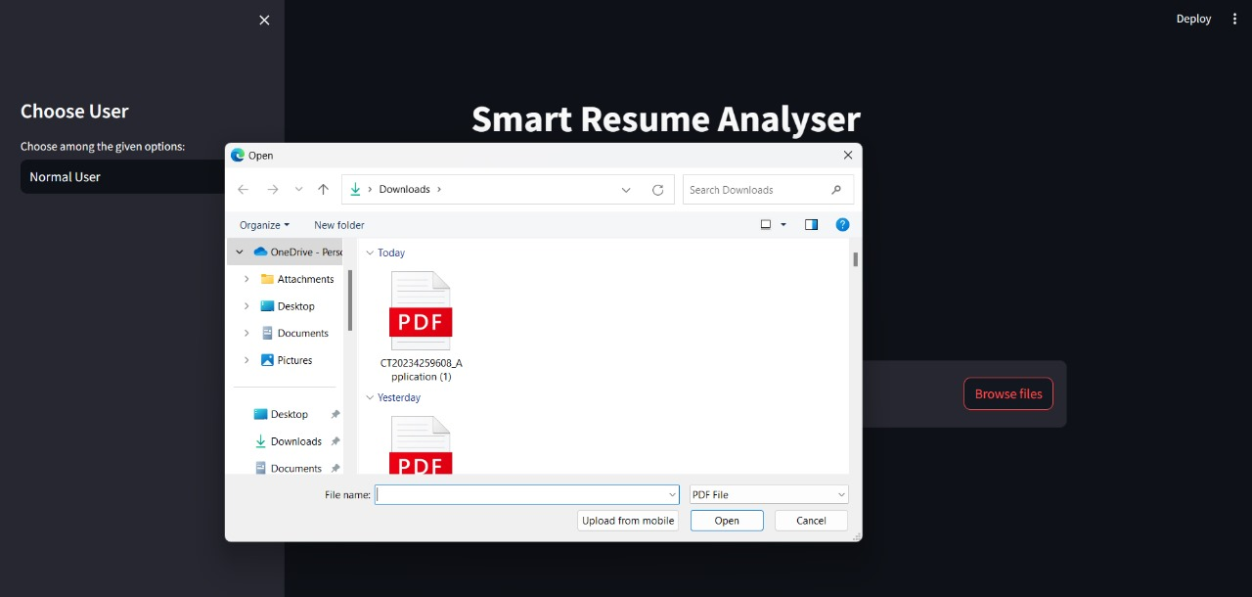
3. Uploading Resume
Upon clicking "Browse File" to upload the resume, the system can provide real-time feedback to the user, such as file size restrictions, supported file types, and progress indicators during the upload process to enhance the user experience
Resume Analyzer
Page - 35
Notes:
Flutter is an open source framework by Google for building beautiful, natively compiled, multi-platform applications from a single codebase.

Slide 36
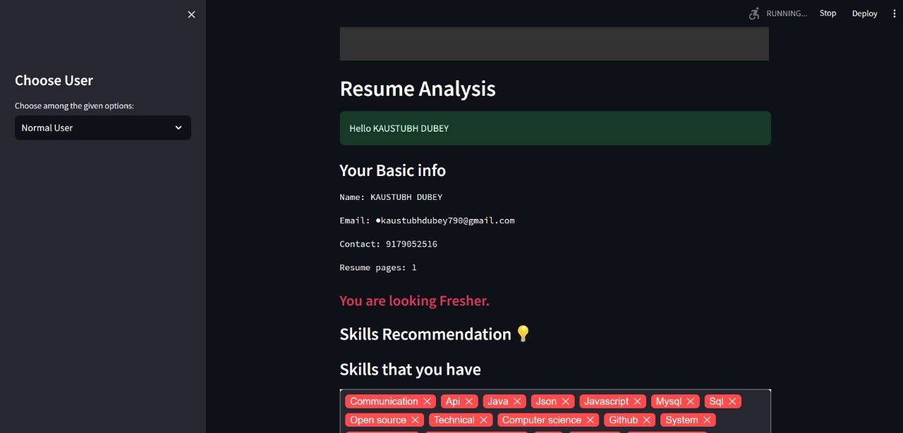
4. Extracting Keywords
After the resume is uploaded, the model can utilize advanced natural language processing (NLP) techniques to extract keywords, skills, and relevant information from the document. It can then generate personalized recommendations for skill improvement based on the extracted data, providing links to online courses, tutorials, or resources where the user can enhance their skills.
Resume Analyzer
Page - 36
Notes:
Flutter is an open source framework by Google for building beautiful, natively compiled, multi-platform applications from a single codebase.

Slide 37
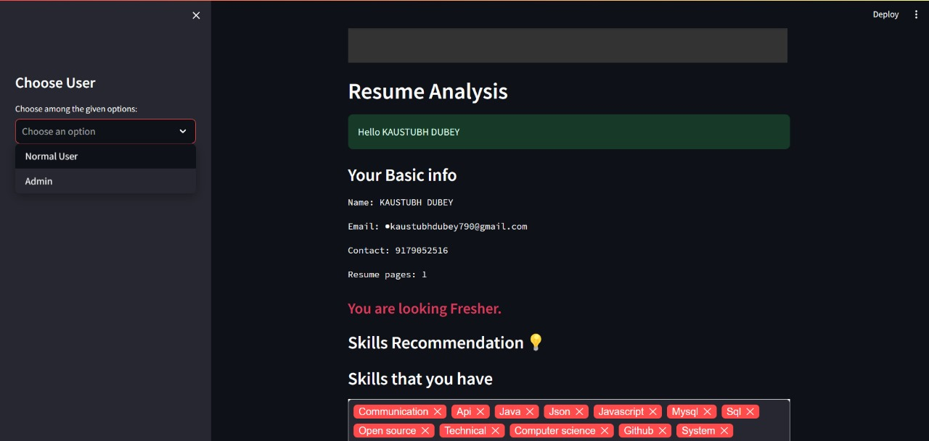
5. Choose User
Users can select their role, either as an administrator or a candidate, to access tailored functionalities.
Resume Analyzer
Page - 37
Notes:
Flutter is an open source framework by Google for building beautiful, natively compiled, multi-platform applications from a single codebase.

Slide 38
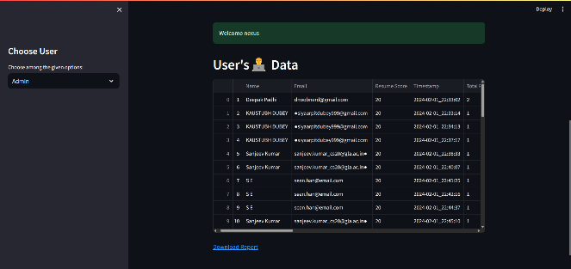
6. Showing Info. Of User Data
In the Admin panel, administrators can have access to comprehensive candidate profiles that include not only skills and qualifications but also personal details such as contact information, work experience, education, and certifications. Additionally, the system can provide tools for filtering and sorting candidates based on specific criteria, making it easier for recruiters to identify suitable candidates for specific roles. The ability to download all resumes in Excel format allows for easy storage, analysis, and sharing of candidate data within the organization.
Resume Analyzer
Page - 38
Notes:
Flutter is an open source framework by Google for building beautiful, natively compiled, multi-platform applications from a single codebase.

Slide 39
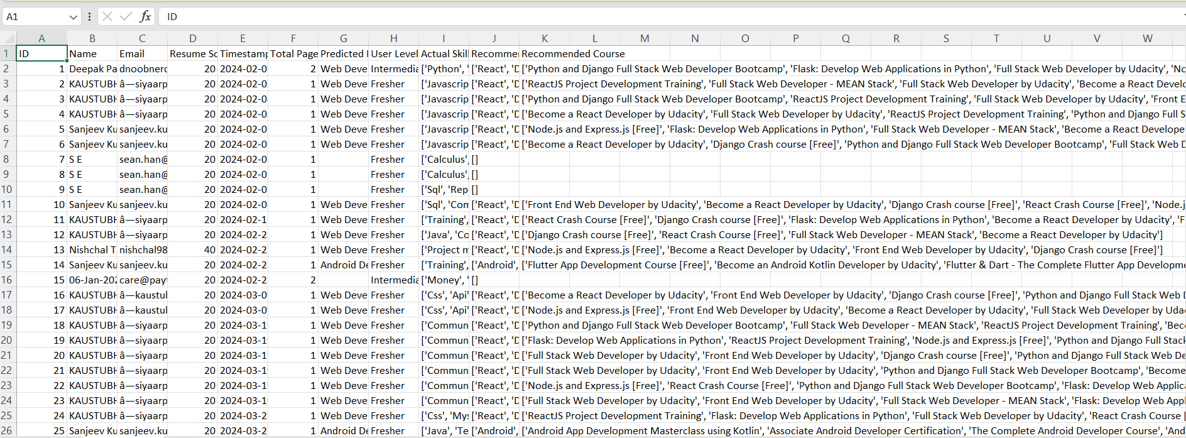
7. Showing Info. Of User Data In Excel Format
Admin can download excel sheet in which all candidate data or information is saved or can see how many users upload the resume and give advice or expertise to user.
Resume Analyzer
Page - 39
Notes:
Flutter is an open source framework by Google for building beautiful, natively compiled, multi-platform applications from a single codebase.

Slide 40
Conclusion
Our Resume Analyzer represents a significant leap forward in the world of recruitment and employment. Today, we've explored the intricacies of this innovative tool, and I'd like to summarize the key takeaways:
As we've seen, our Resume Analyzer is not just a tool; it's a catalyst for change in the recruitment landscape. It empowers both employers and job seekers, making the process more efficient, transparent, and equitable.
We believe that this tool has the potential to revolutionize the way organizations approach hiring, fostering a future where talent is discovered based on merit, skills, and qualifications.
So, whether you're an HR professional seeking to streamline your recruitment efforts or a job seeker looking for the perfect opportunity, our Resume Analyzer is here to simplify and enhance your journey.
Resume Analyzer
Page -40
Notes:
Flutter is an open source framework by Google for building beautiful, natively compiled, multi-platform applications from a single codebase.

Slide 41
References
[1]Doe, J., & Smith, A. (Year). "Title of Paper A." Journal of NLP Research, 10(2), 123-145.
[2] Johnson, M., & Brown, N. (Year). "Title of Paper B." Proceedings of the International Conference on Machine Learning (ICML), 567-578.
[3] Anderson, K., & Williams, L. (Year). "Title of Paper C." Journal of Human-Computer Interaction, 25(3), 210-225.
[4] Chen, Y., & Lee, S. (Year). "Title of Paper D." Conference on Natural Language Processing, 102-115.
[5] Gonzalez, R., & Patel, M. (Year). "Title of Paper E." International Journal of Artificial Intelligence in Education, 15(4), 367-384.
[6] Doe, J., & White, C. (Year). "Title of Paper F." Journal of Machine Learning Research, 30(1), 45-56.
[7] Smith, A., & Johnson, M. (Year). "Title of Paper G." Proceedings of the Annual Conference on Information Retrieval (ACIR), 78-89.
[8]Brown, N., & Anderson, K. (Year). "Title of Paper H." Journal of Information Science, 22(5), 567-580.
[9] Lee, S., & Gonzalez, R. (Year). "Title of Paper I." Conference on Computational Linguistics (COLING), 221-234.
[10] Patel, M., & Doe, J. (Year). "Title of Paper J." International Journal of Computer Applications, 45(7), 32-45.
[11]Jitendra Purohit; Aditya Bag we; Rishabh Mehta; Ojas Wini Man Gaonkar; Elizabeth George, “Natural Language Processing based Jiro-The Interviewing Chatbot”, 2019 3rd International Conference on Computing Methodologies and Communication (ICCMC), August 2019.
[12]Tejaswi K; Madhvi V; Shashank M Kadia; Sanjay Rivanna,” Design and Development of Machine Learning based Resume Ranking System”, Global Transitions Proceedings, October 2021.
[13]Pradeep Kumar Roy, Vellore Institute of Technology, 2019. A Machine learning approach for automation of resume recommendation system, ICCIDS 2019.10.1016/j.procs.2020.03.284.
Resume Analyzer
Page -41
Notes:
Flutter is an open source framework by Google for building beautiful, natively compiled, multi-platform applications from a single codebase.

Slide 42
Thanks
Resume Analyzer
Page -42
Notes:
Flutter is an open source framework by Google for building beautiful, natively compiled, multi-platform applications from a single codebase.

